Slide 1
The suicide impact during the Coronavirus pandemic
Ana Beatriz Oliveira de Macedo
Bruna Bellini Faria
Thiago Rodrigues de Jesus Carvalho

Slide 2
Warning
We inform that this presentation contains information about suicide and mental health(It does not contain any type of rough content), in case you are not confortable, we suggest to not continue.

Slide 3
Why did we chose this theme?
Causes of suicide in the world
{
Depression
Stress
Anxiety
Media (social media, news)
Family
Society padrons
Social isolation
Contributed to the aggravation of causes
High number of cases
Mental health diseases have grown during the pandemic
Suicide was one of the consequences

Slide 4
The process of the research
Elaboration of graphics and wordclouds
Search for all kinds of Data
1
2
3
4
Reflect on their importance
Conclusion and the creation of the App

Slide 5
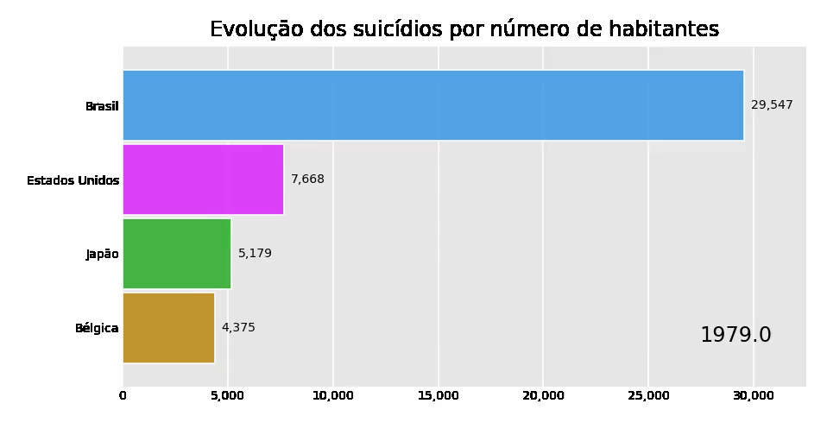
Evolution of suicide victims over the years
Smaller = worse
Deaths per 100.000 inhabitants
Source:
https://www.kaggle.com/russellyates88/suicide-rates-overview-1985-to-2016
https://pt.countryeconomy.com/demografia/mortalidade/causas-morte/suicidio/belgica

Slide 6
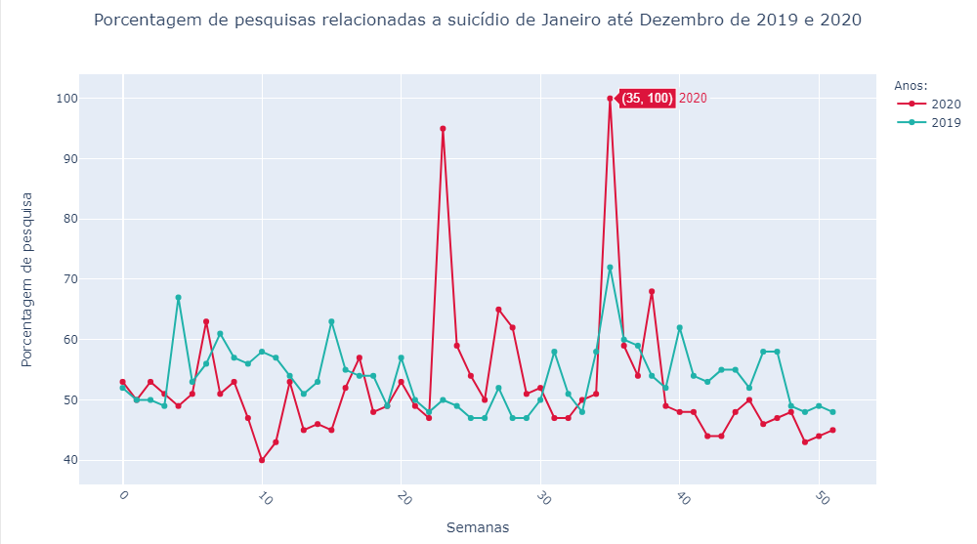
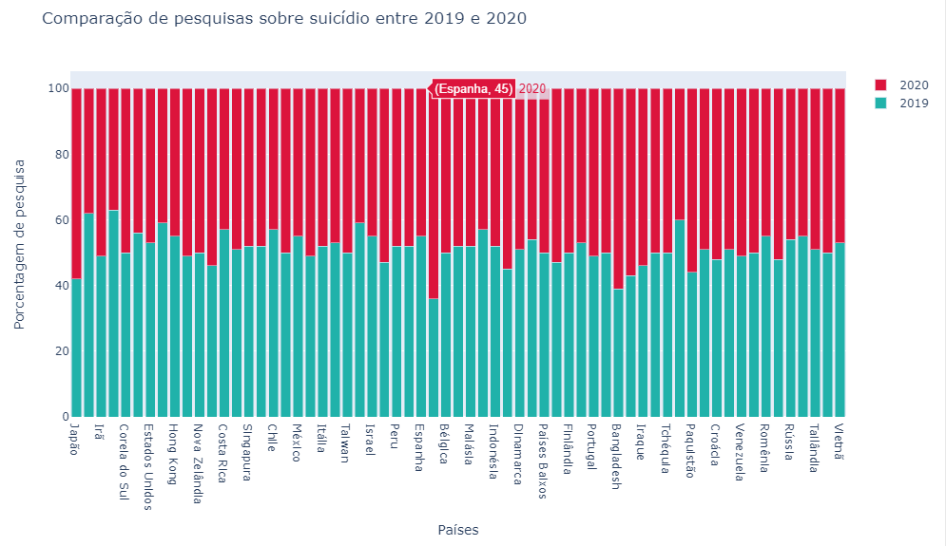
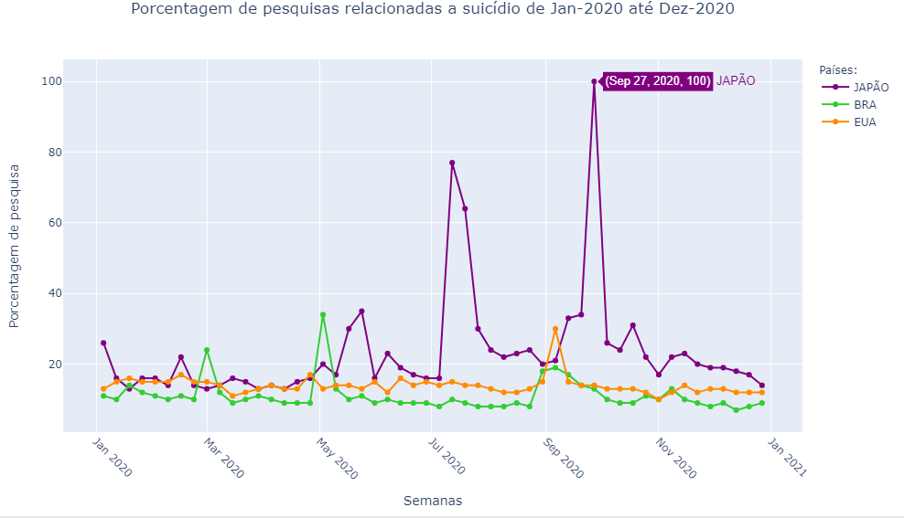
Google trends search on the topic “suicide”
2019 X 2020
High peaks: Black Lives Matter and texan man commits suicide in June. Setembro Amarelo in the second peak
Japan han a high level of researches
Bélgica had high percentage of searches during the pandemic
Countries with a high human development index also suffers with mental health.
Fonte:
https://trends.google.com.br/trends/?geo=BR

Slide 7
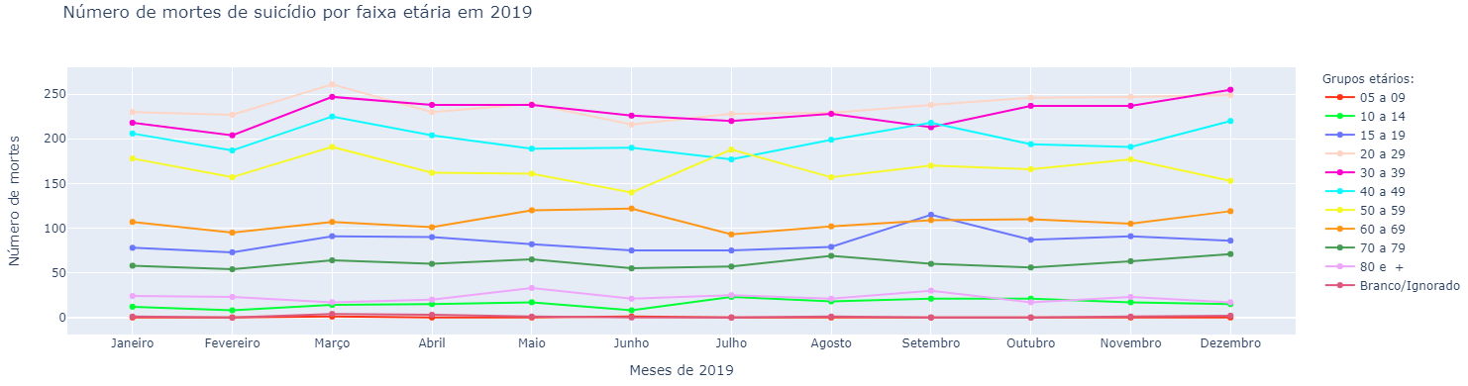
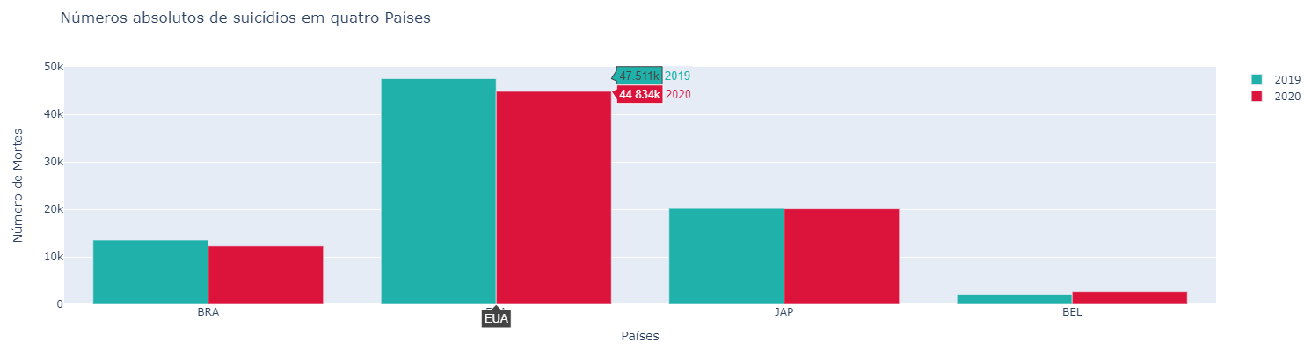
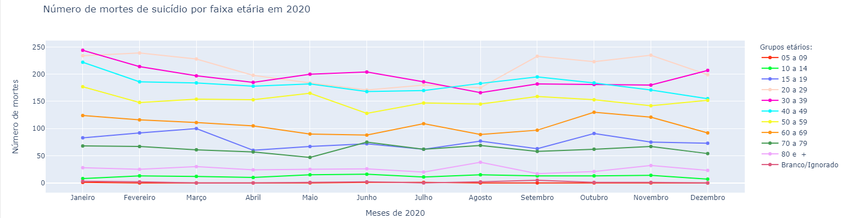
Suicide analysis in Brazil (2019 X 2020)
People aged 10 to 39 years had a reduction in the number of suicides.
From 70 to 80 the number of suicides has grown.
Fonte:
http://svs.aids.gov.br/dantps/centrais-de-conteudos/paineis-de-monitoramento/mortalidade/cid10/

Slide 8
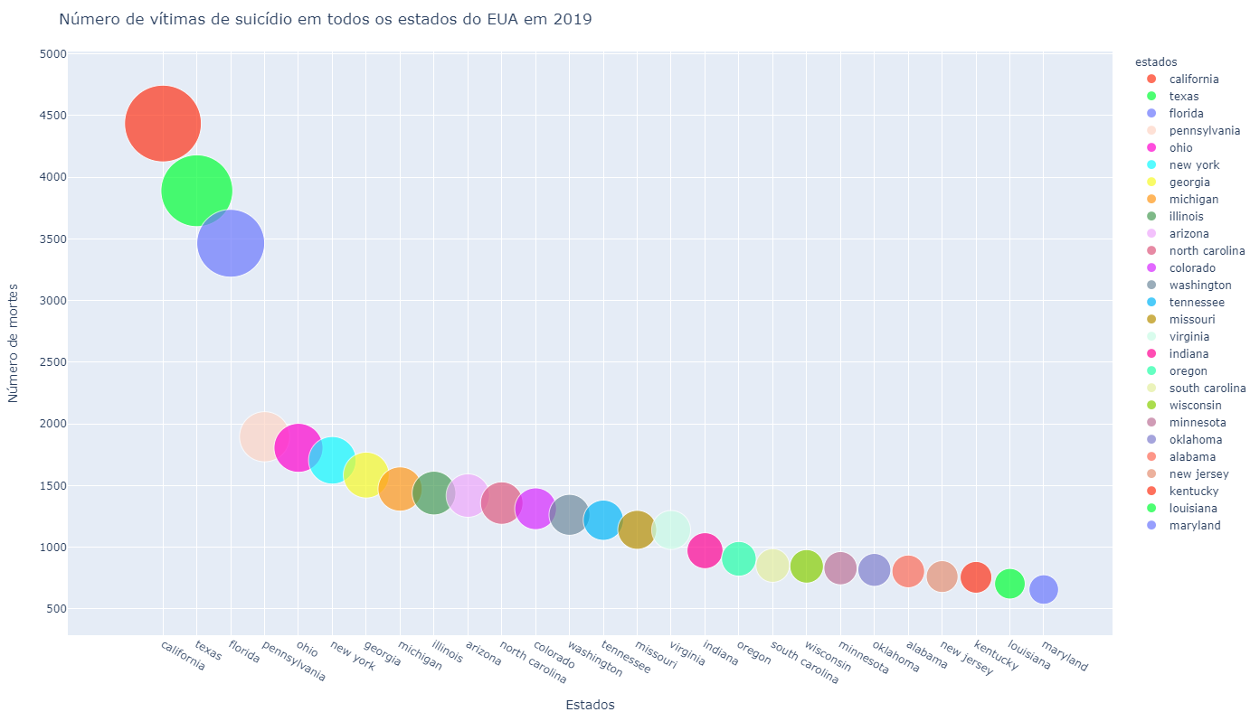
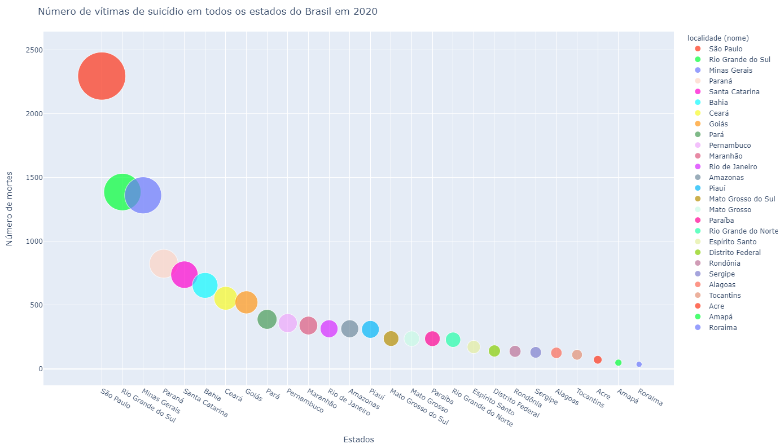
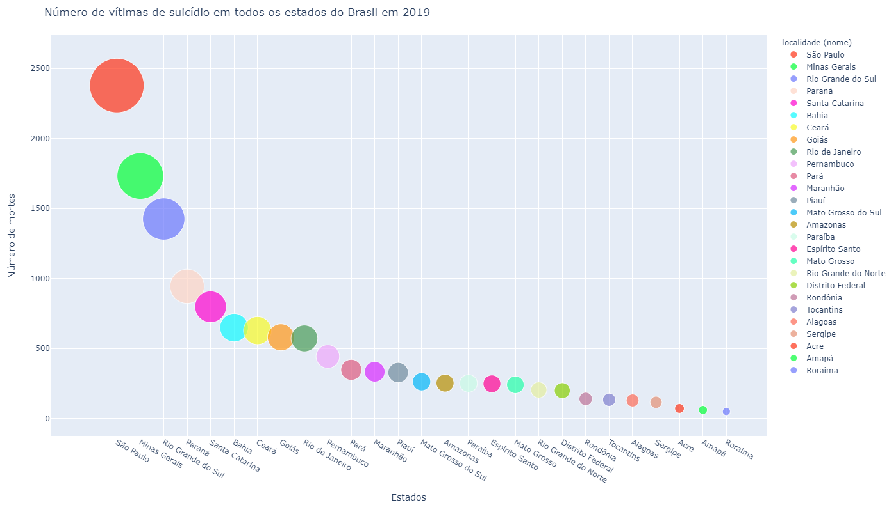
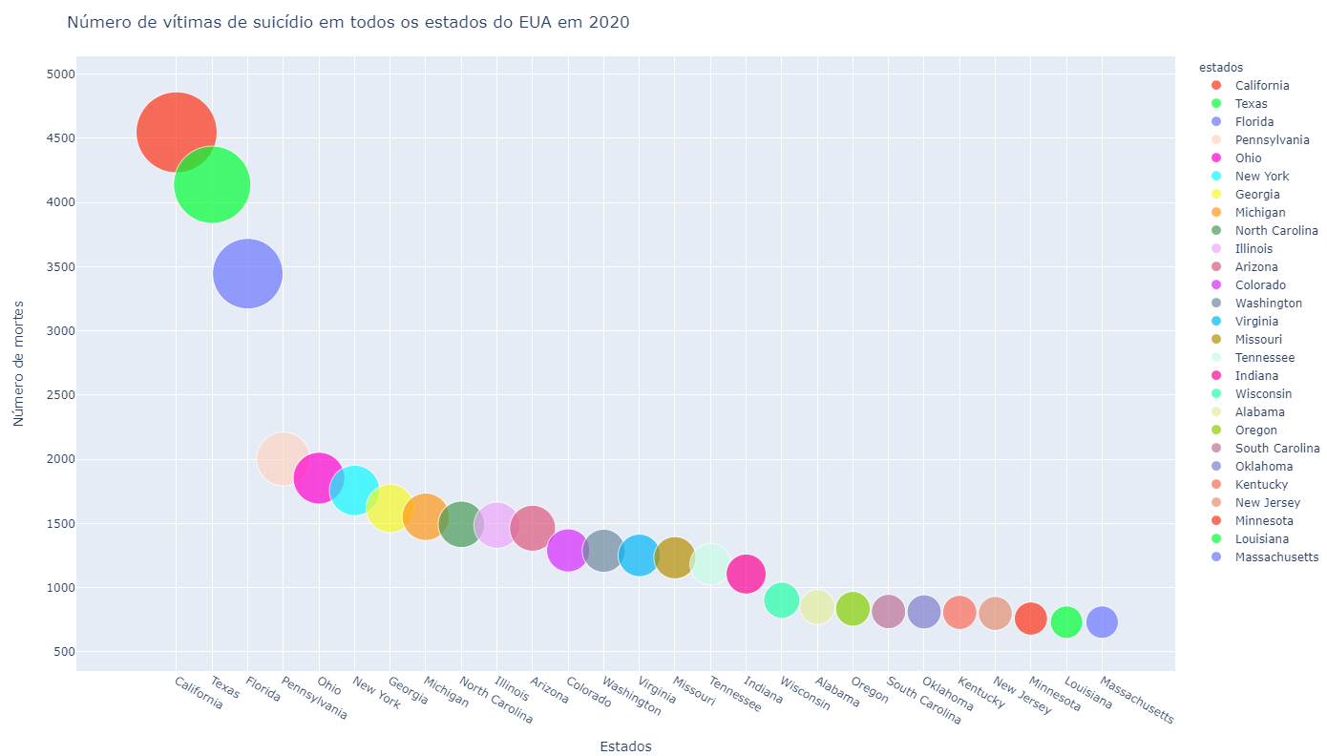
Suicide analysis by state(Brazil and USA)
Higher number of cases= State with the largest population
Suicide taboo happen more in low efficiency places
Fontes:
https://www.cdc.gov/nchs/pressroom/sosmap/suicide-mortality/suicide.htm

Slide 9
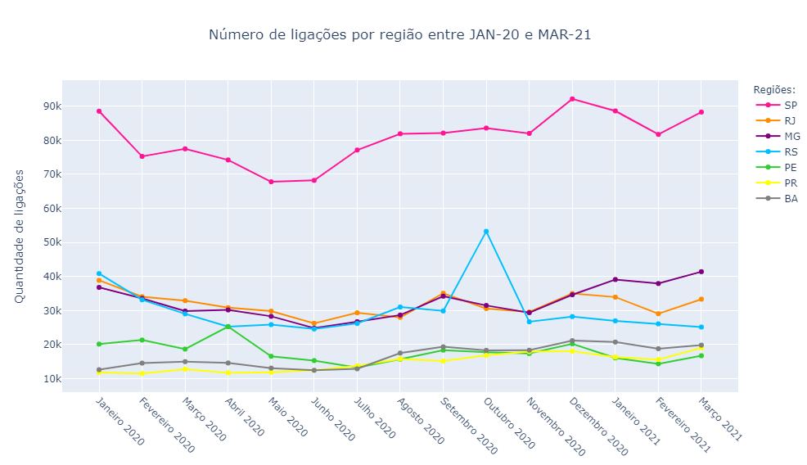
Life appreciation center in Brazil(CVV)
Region with more cases= highest number of calls
79,3% of the population has at least one phone(IBGE)
Call rate higher than monthly death

Slide 10
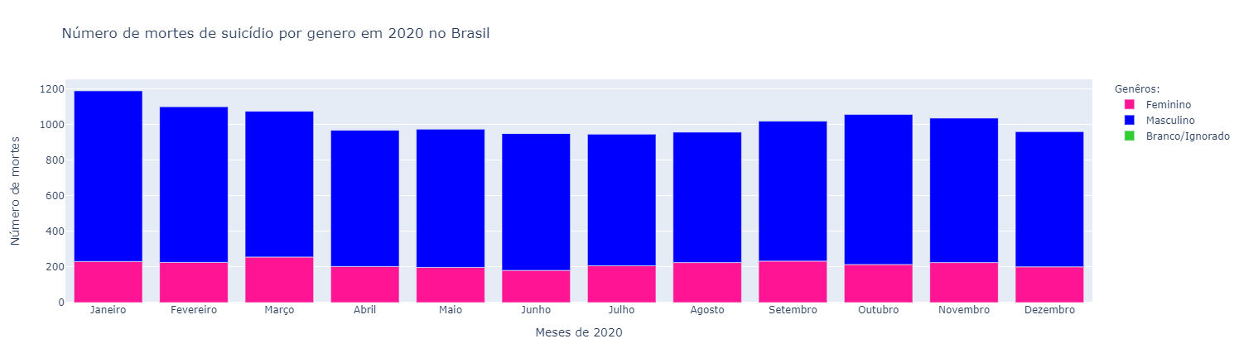
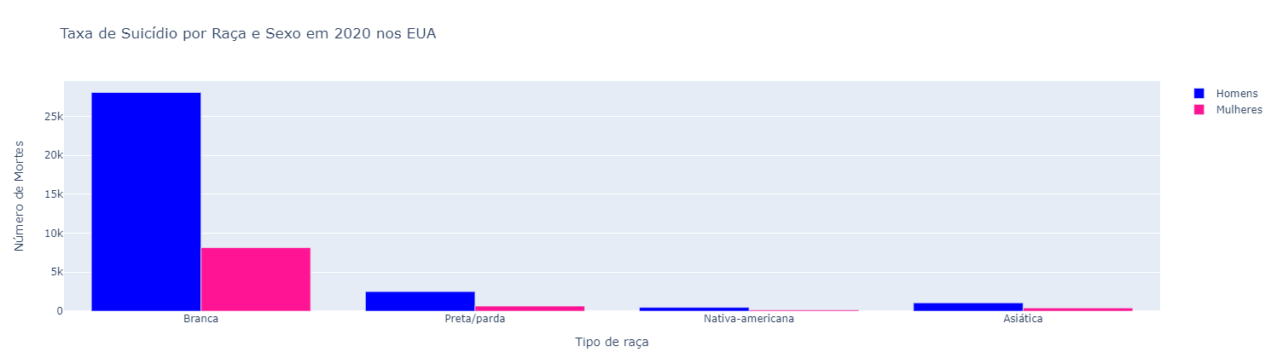
Suicide analysis by gender(Brazil and USA)
Mostly men
Men have a hard time reaching out for help
Fragile masculinity
The percentage of suicide commited by men is three times higher or 75% of the total.
Fonte:
http://svs.aids.gov.br/dantps/centrais-de-conteudos/paineis-de-monitoramento/mortalidade/cid10/

Slide 11
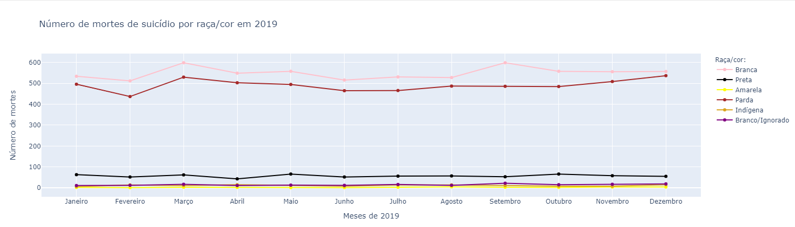
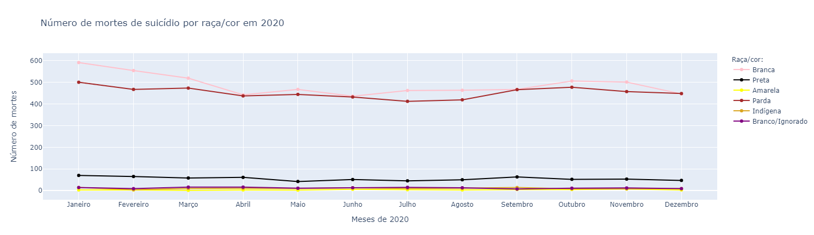
Suicide analysis by race(Brazil and USA)
Disparidades raciais e étnicas
Raça branca maior quantidade de mortes
Dores e problemas diferentes
Enxergar ou não um futuro/salvação
Racial and ethnic disparities
The White race has the highest number of deaths by suicide
Fonte:
http://svs.aids.gov.br/dantps/centrais-de-conteudos/paineis-de-monitoramento/mortalidade/cid10/

Slide 12
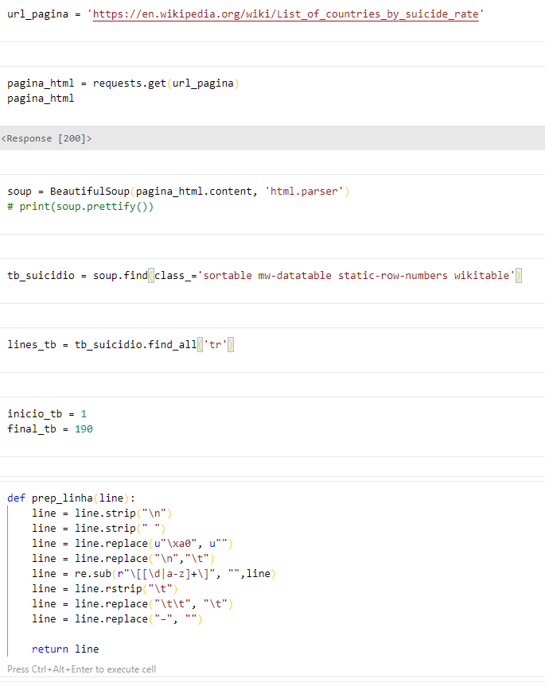
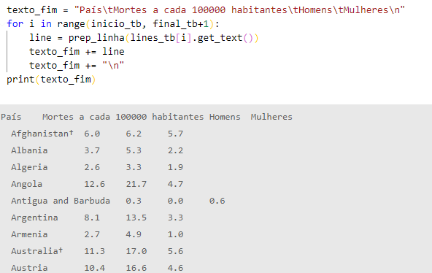
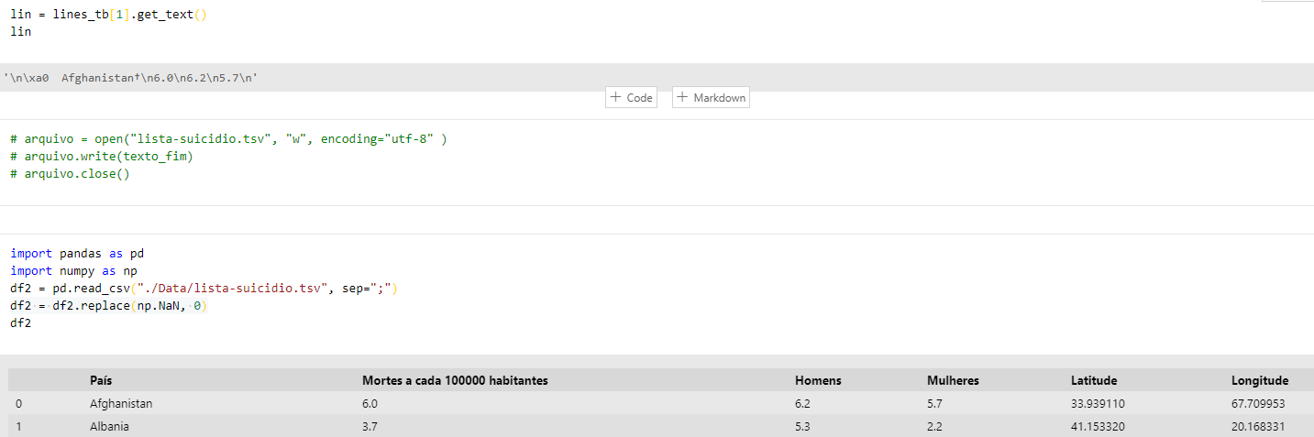
Global analysis(Wikipedia)
Fonte:
https://en.wikipedia.org/wiki/List_of_countries_by_suicide_rate

Slide 13
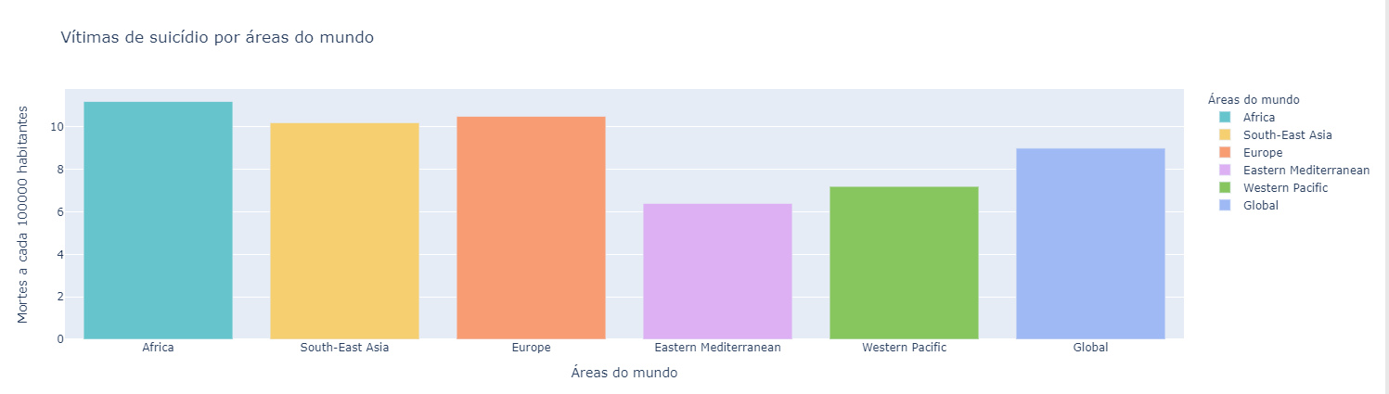
Continent analysis
Africa has the highest percentage of victims
Lack of professional help and research into causes
Depression can lead to suicidal thoughts
Fonte:
https://en.wikipedia.org/wiki/List_of_countries_by_suicide_rate

Slide 14
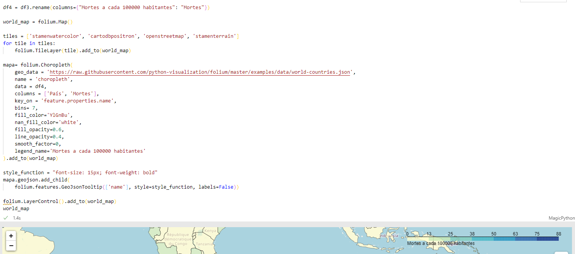
Fonte:
https://en.wikipedia.org/wiki/List_of_countries_by_suicide_rate

Slide 15
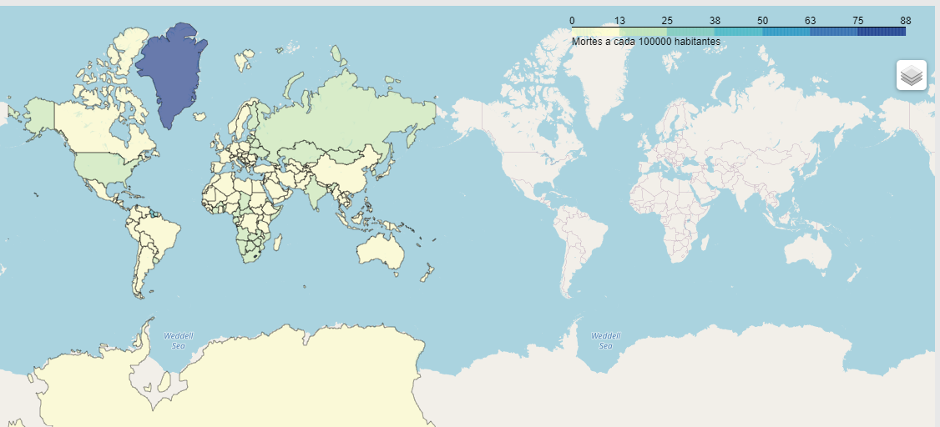
World map on suicide rates
Deaths per 100 000 inhabitants
Greenland (83%): suffers by constant change in their lifestyle
Lesoto (87.5%)
Guyana
Fonte:
https://en.wikipedia.org/wiki/List_of_countries_by_suicide_rate

Slide 16
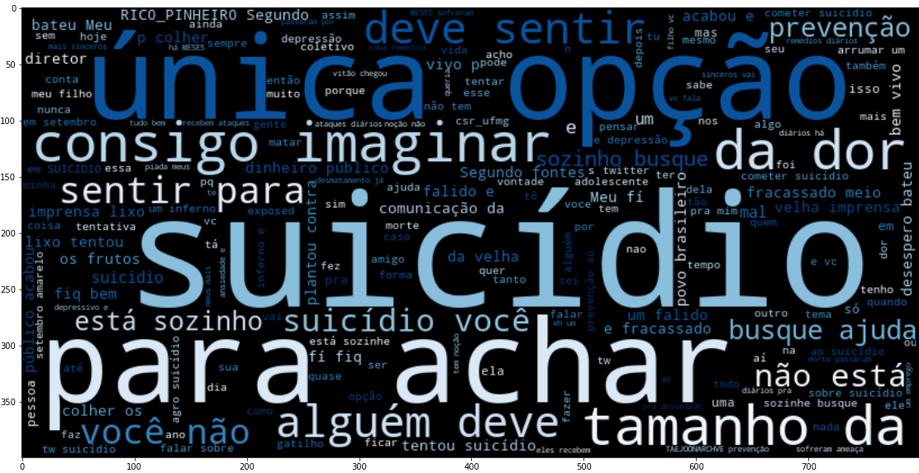
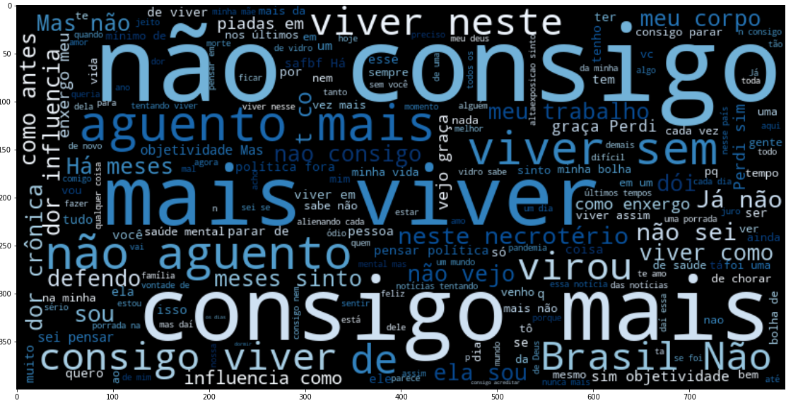
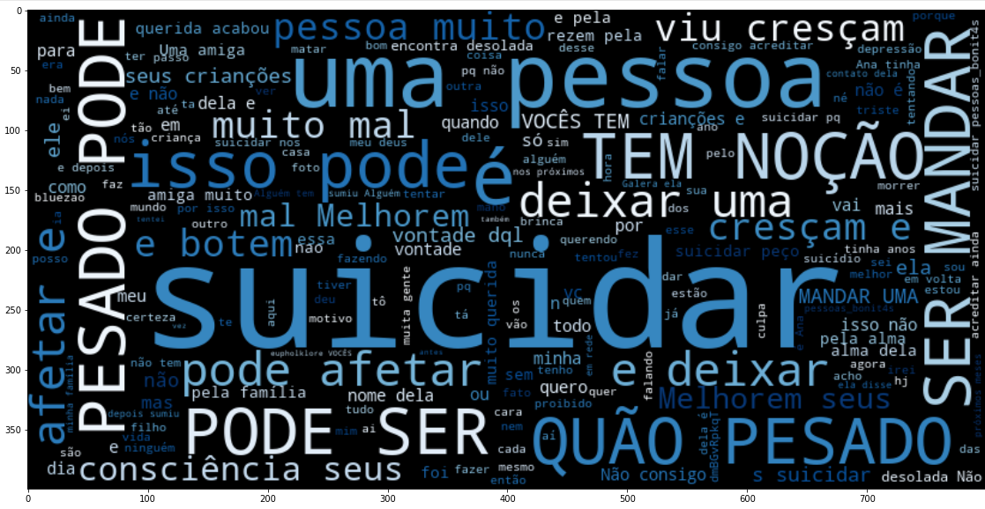
Twitter wordcloud analysis
Tweets analysis(Words: “suicide”, “commit suicide”, “I cannot handle it anymore”)
Strong/bold words
The need to express what you are feeling anonymously or not in social media
Talk freely to someone who will not judge you
Source:
https://twitter.com/home?lang=pt

Slide 17
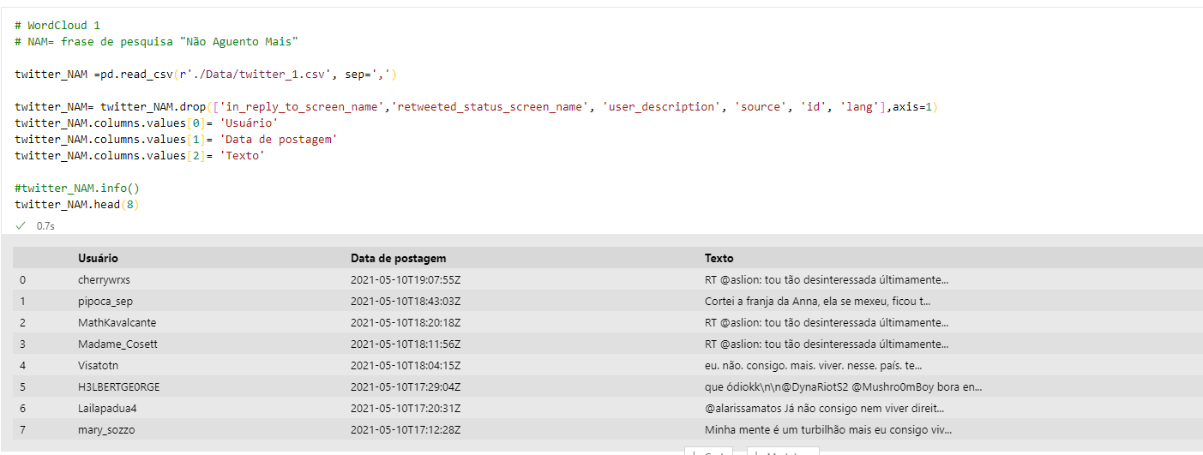
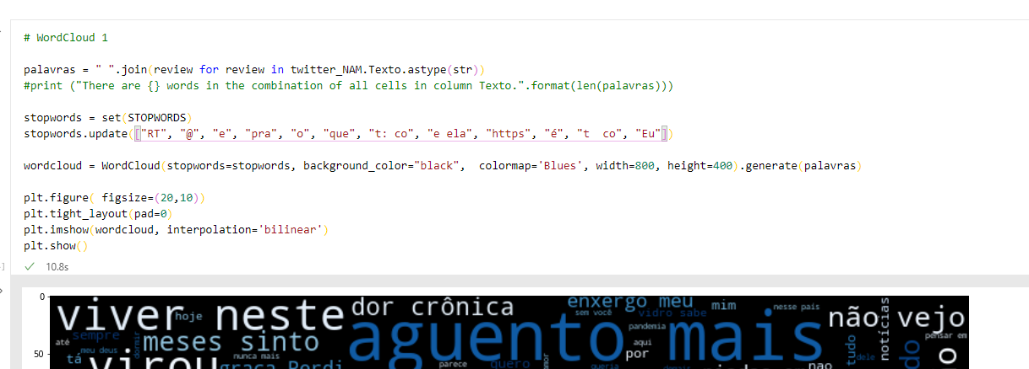

Slide 18
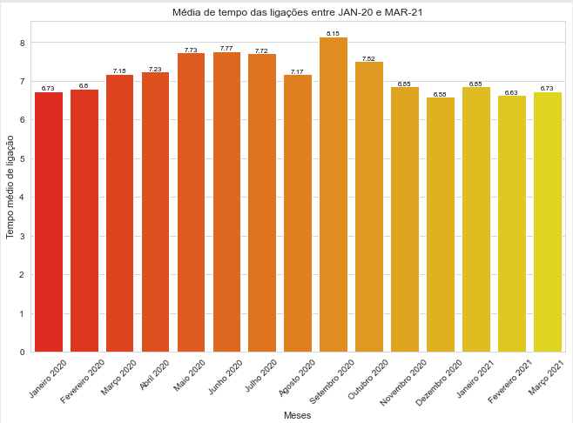
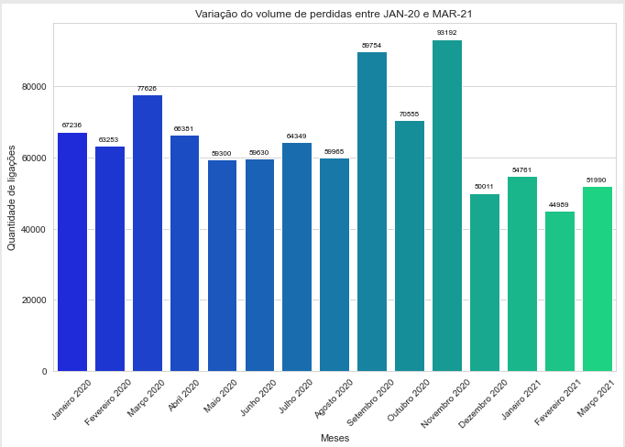
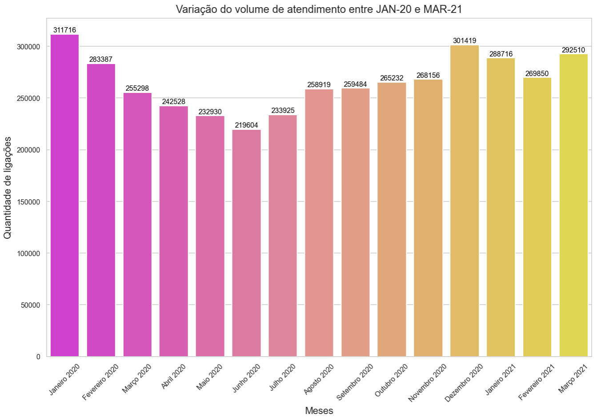
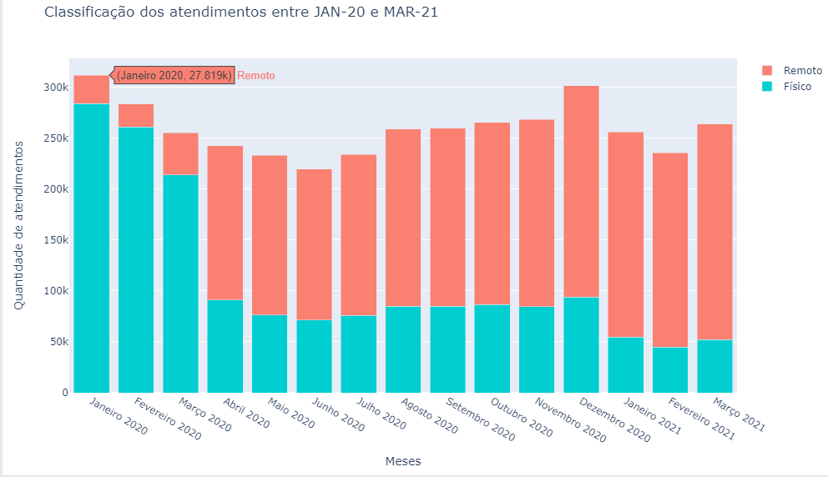
Remote x Physical appointments during the pandemic
CVV
The need to talk about how you feel
Taboo
The change from physical to remote services
Demand for technology
Fontes:
https://www.cvv.org.br/wp-content/uploads/2017/05/2020_05_06_CVV_Relatorio_Mensal_Abril20.pdf
https://www.cvv.org.br/wp-content/uploads/2017/05/2020_07_CVV_Relatorio_Mensal_Maio.pdf
https://www.cvv.org.br/wp-content/uploads/2017/05/CVV-Relatorio-Mensal-Junho-e-Julho-2020.pdf
https://www.cvv.org.br/wp-content/uploads/2017/05/CVV-Relatorio-Mensal-Agosto-e-Setembro-2020_baixa.pdf
https://www.cvv.org.br/wp-content/uploads/2021/03/CVV-Relatorio-Mensal-Dezembro-2020_baixa.pdf
https://www.cvv.org.br/wp-content/uploads/2017/05/CVV-Relatorio-1-Trimestre-2021_Baixa.pdf

Slide 19
Fale Sobre APP
Interface that would help families, friends, comrades that are worried aobut someone in their life who might be going through a hard phase and having suicidal thoughts.
The questionaire is composed by 13 diferent outcomes which will show the person how she/he can help the person that they are worried about in the most correct way.
We would like to provide help from others to those who cannot get help with help desks or who that does not have the commitment or strength to seek help by themselves.
​
​

Slide 20


Concorrente ou complementar?
Atendimentos presenciais​ e remoto
Ajuda de imediato com uma equipe treinada
Difícil acesso a comunicação pelo volume de busca por ajuda
​
Para quem está passando por qualquer tipo de problema ou crise​ e necessita colocar tudo para fora
Atendimento remotos
Dinâmicas pré prontas fáceis e diretas​
Direcionamento das atividades por meio de formulários
Para as pessoas próximas ou conhecidos, que desejam ajudar ou descobrir se a ajuda é necessária para o outro

Slide 21




App structure
Help
User
Contact us about anything related to the app
Menu
Diagnostic after the form
Who are we?
Learn more
Users
Yellow september
Research data
To undertand the current situation of the person you would like to help
Identifying the situation and understand how you can help them

Slide 22
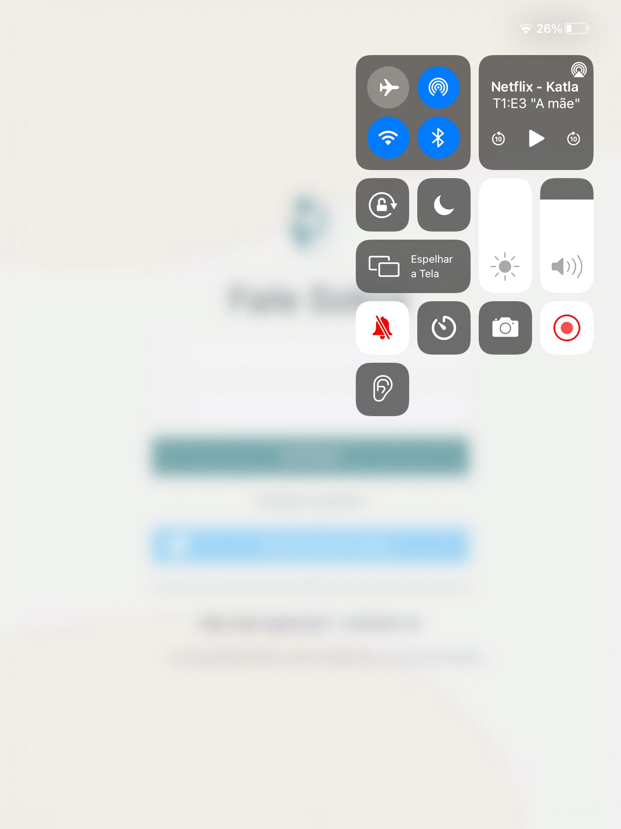
Simulation

Slide 23
Conclusion
Be open minded and search for ways that will make you understand more about what really is suicide and how you can help someone
Know how to recognize if someone needs help
Lessen the taboo in society and speak freely about it
Learn and understand the correct ways to help someone in need depending of their current mind situation.

Slide 24
“It’s not DRAMA, it’s not to draw attention! Mental health is just important as physical health”

